Slide 1
07/02/2022
Title: Multiplication and division
Aim:
Be able to apply the 4 operations to integers.
Plan:
Daily review:
4 operations - integers.
Independent practice – mixed operations.

Slide 2
4 operations with integers
Addition and subtraction:
Using the number line:
Need a
S_ _ _ _ _ _ _ _ _ _ _ t
D _ _ _ _ _ _ _ _ and
N _ _ _ _ _ _ _ p _ _ _ _ _
Consider -4 – 6
-4 – 6
Notes:
Student worksheet 1

Slide 3
4 operations with integers
Addition and subtraction:
Using the number line:
Need a
S_ _ _ _ _ _ _ _ _ _ _ t
D _ _ _ _ _ _ _ _ and
N _ _ _ _ _ _ _ p _ _ _ _ _
Starting point
Direction and
Number of places
Consider -4 – 6
-4 – 6
Number of places
Starting point
Direction

Slide 4
Double signs:
Adding a negative number is the same as _____________ .
Subtracting a negative number is the same as __________.
5 + (-6) can be written as 5 ______
-7– (-3) can be written as -7 ______
Multiplication and division:
Multiplying a positive number by a negative number will always give a ____________ result.
Multiplying a negative number by a positive number will always give a result.
Multiplying a negative number by a negative number will always give a ___________ result.
Notes:
Worksheet 2

Slide 5
Double signs:
Adding a negative number is the same as
Subtracting a negative number is the same as
subtracting.
adding.
– 6
5 + (-6) can be written as 5
+ 3
-7– (-3) can be written as 7
Multiplication and division:
Multiplying a positive number by a negative number will always give a ____________ result.
negative
Multiplying a negative number by a positive number will always give a ______________ result.
negative
Multiplying a negative number by a negative number will always give a ___________ result.
positive

Slide 6
Multiplication and division:
Dividing a positive number by a negative number will always give a ____________ result.
Dividing a negative number by a positive number will always give a ______________ result.
Dividing a negative number by a negative number will always give a ___________ result.
Notes:
Worksheet 3

Slide 7
Multiplication and division:
Dividing a positive number by a negative number will always give a ____________ result.
negative
Multiplying a negative number by a positive number will always give a ______________ result.
negative
Multiplying a negative number by a negative number will always give a ___________ result.
positive

Slide 8
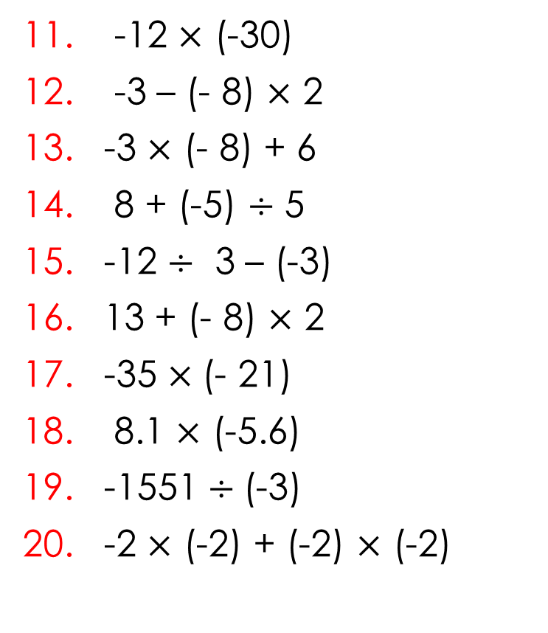
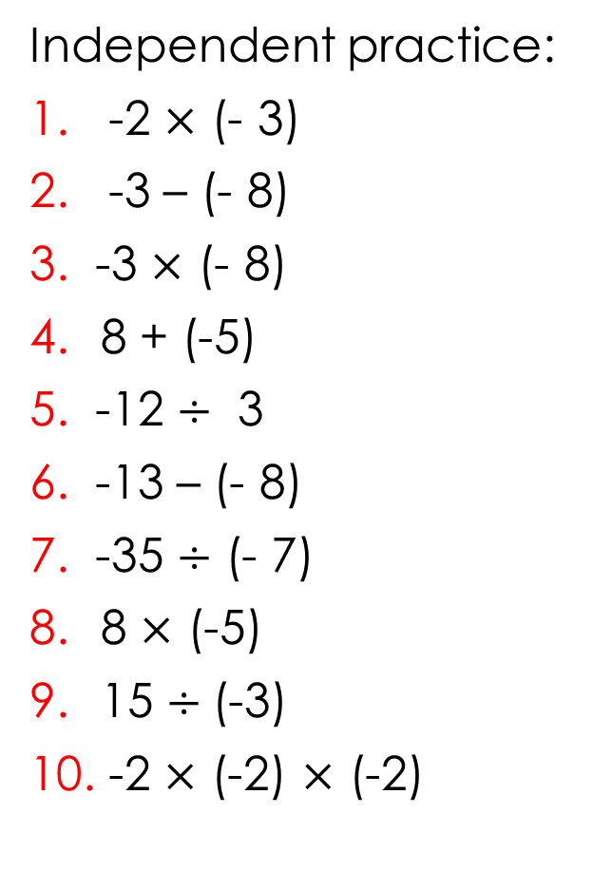
Exercise books: Correct setting out.
Independent practice:
1. -2 $×$ (- 3)
2. -3 – (- 8)
3. -3 $×$ (- 8)
8 + (-5)
5. -12 $÷$ 3
6. -13 – (- 8)
7. -35 $÷$ (- 7)
8 $×$ (-5)
15 $÷$(-3)
10. -2 $×$ (-2) $×$ (-2)
11. -12 $×$ (-30)
12. -3 – (- 8) $×$ 2
13. -3 $×$ (- 8) + 6
14. 8 + (-5) $÷$ 5
15. -12 $÷$ 3 – (-3)
16. 13 + (- 8) $×$ 2
17. -35 $×$(- 21)
18. 8.1 $×$ (-5.6)
19. -1551 $÷$(-3)
20. -2 $×$ (-2) + (-2) $×$ (-2)

Slide 9
Individual practice
Complete the activity sheet from Thursday.

Slide 10

Reflection
Aim:
Be able to apply the 4 operations to integers.
Write 1 tip for each operation ( +, - , x and $÷$)

